Slide 1
Rumor Detection on Social Media with Bi-Directional Graph Convolutional Networks
Zhuomin Chen
2020.04.21
The Thirty-Fourth AAAI Conference on Artificial Intelligence (AAAI-20)

Slide 2
Chongqing University of Technology
ATAI
Advanced Technique of Artificial Intelligence
Chongqing University of Technology
1.Motivation
2.Method
3.Experiment and Result
4.Conclusion

Slide 3
Motivation
Come up a method to identify rumors to identify rumors on social media efficiently and as early as possible.
Conventional detection methods mainly rely on feature engineering ,which is very time-consuming and labor-intensive, they also lack high-level representations.
UD-GCN only aggregates information relied on the relationship among relevant posts but loses the sequential orders of follows.

Slide 4
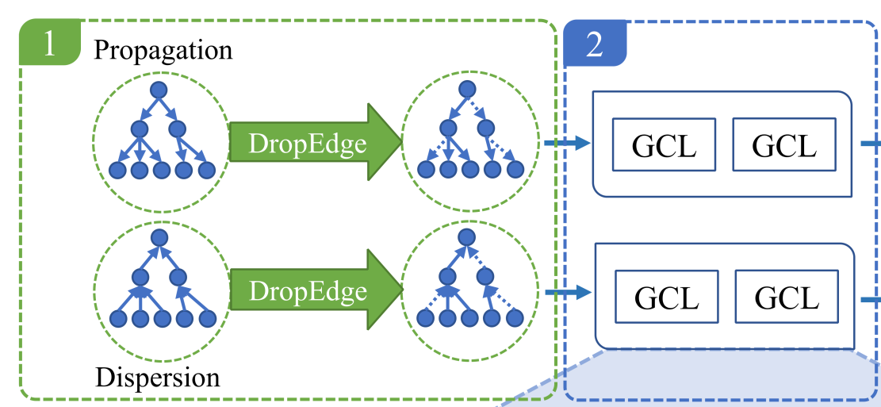
Method(1)

Slide 5
Method(2)

Slide 6
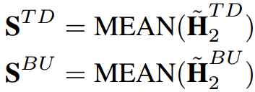
Method(3)

Slide 7
Method(4)

Slide 8
Experiment and Result(1)

Slide 9
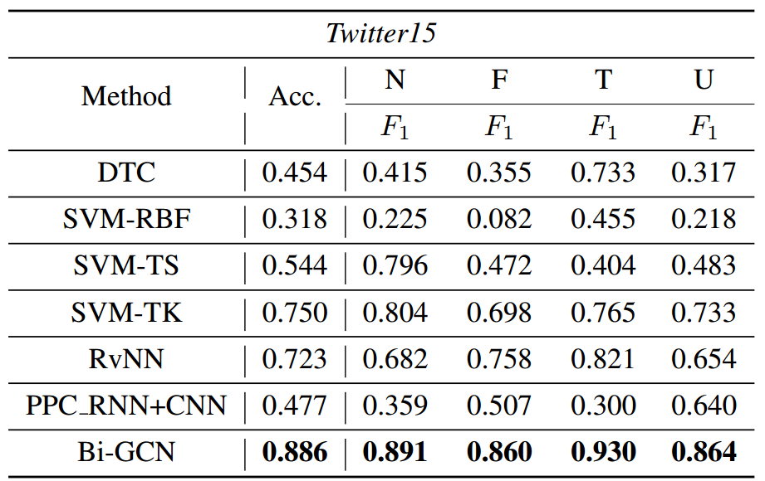
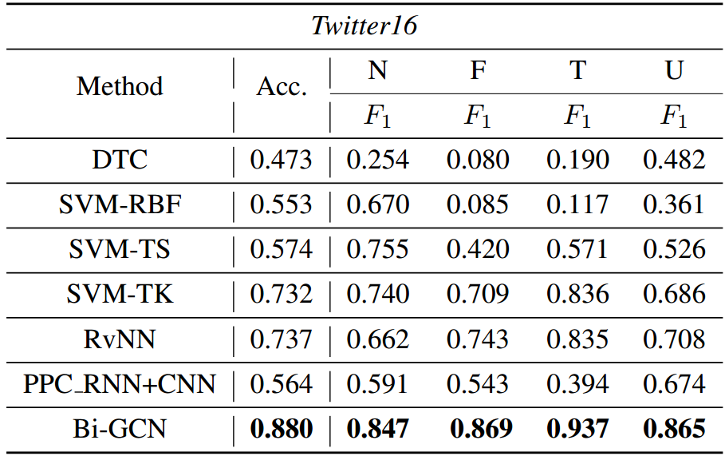
Experiment and Result(2)

Slide 10
Conclusion
Contributions
The first study of employing Bi-GCN in rumor detection of social media.
Not only considers the causal features of rumor propagation along relationship chains from top to down but also obtains the structural features from rumor dispersion within communities through the bottom-up gathering.
Concatenate the features of the source post with other posts at each graph convolutional layer to make a comprehensive use of the information from the root feature.

